Slide 1
PROJECT PROGRESS REPORT
NEX COHORT- GROUP 4
Proposed Project Title:
Smart Hybrid Solar–Micro-Hydropower Charging Station for Students

Slide 2
INTRODUCTION
The project is aimed at developing a small renewable-energy charging station that combines solar power and micro-hydropower to provide electricity for charging students' electronic devices.
This week, our team worked on the CAD design of the proposed charging station using FreeCAD. The design illustrates the station’s overall structure and the arrangement of major components, including the solar panels, hydro turbine and pipe system, battery, monitoring unit, and USB charging ports.

Slide 3
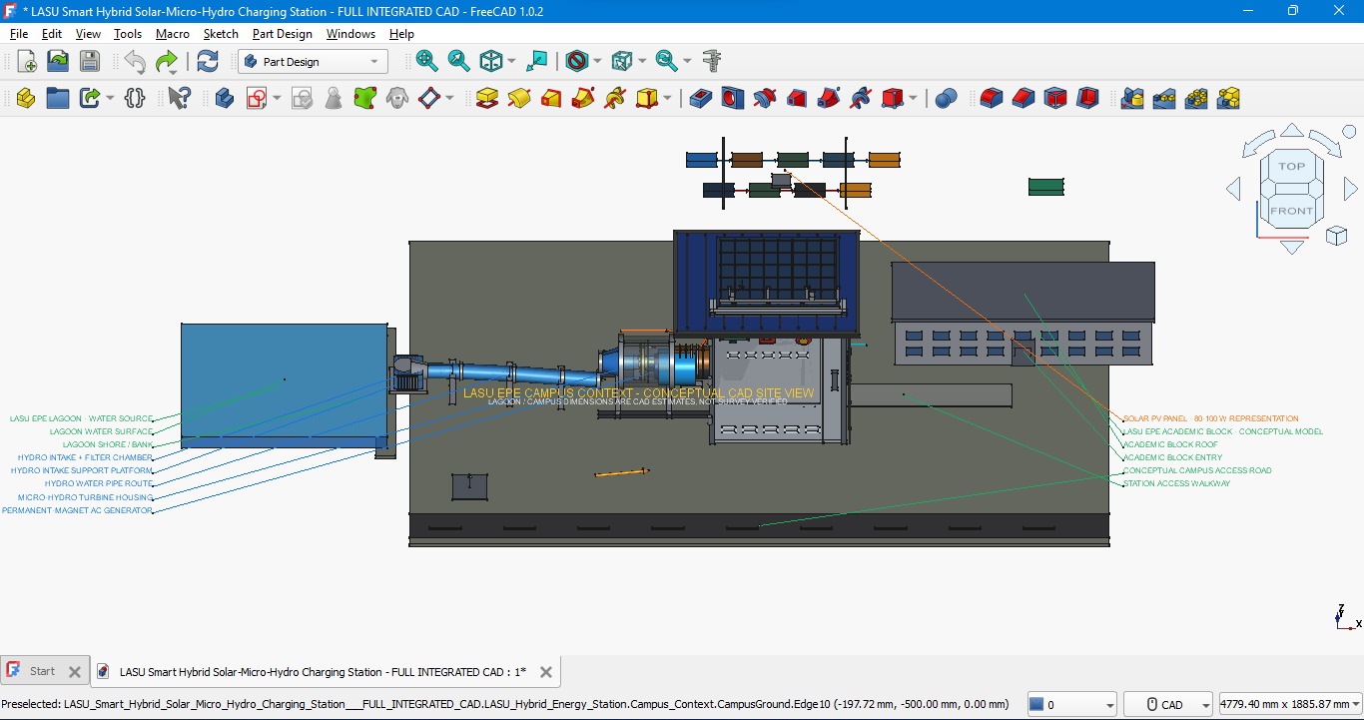

Slide 4
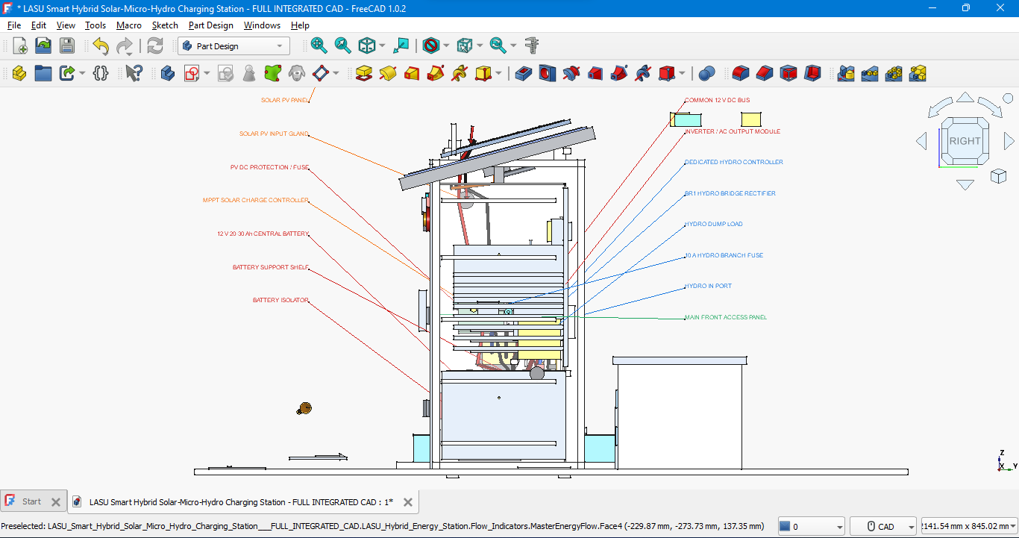
THANK YOU!!!!!

Slide 5
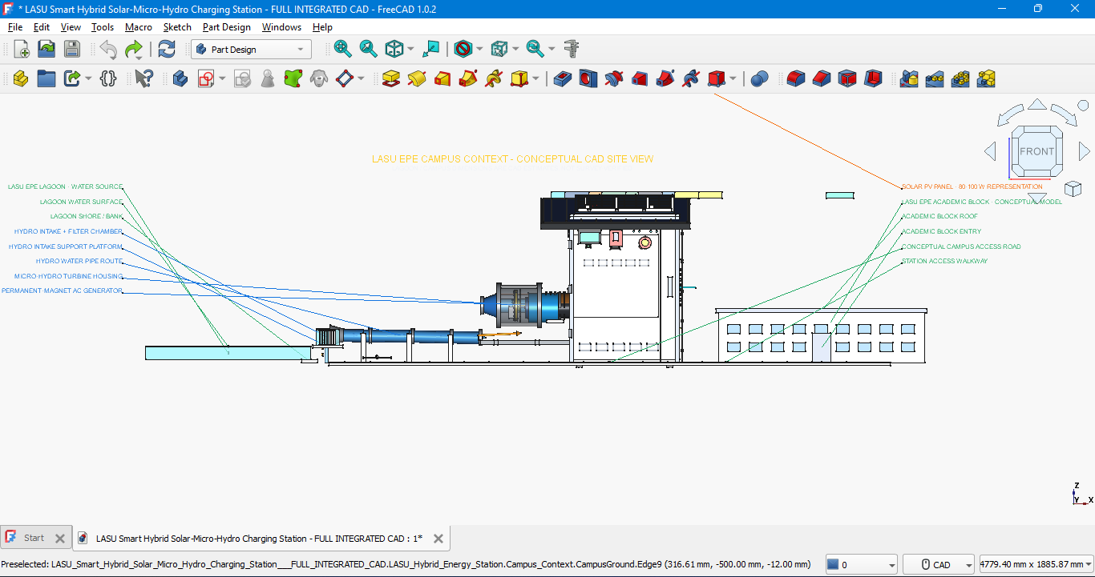

Slide 6
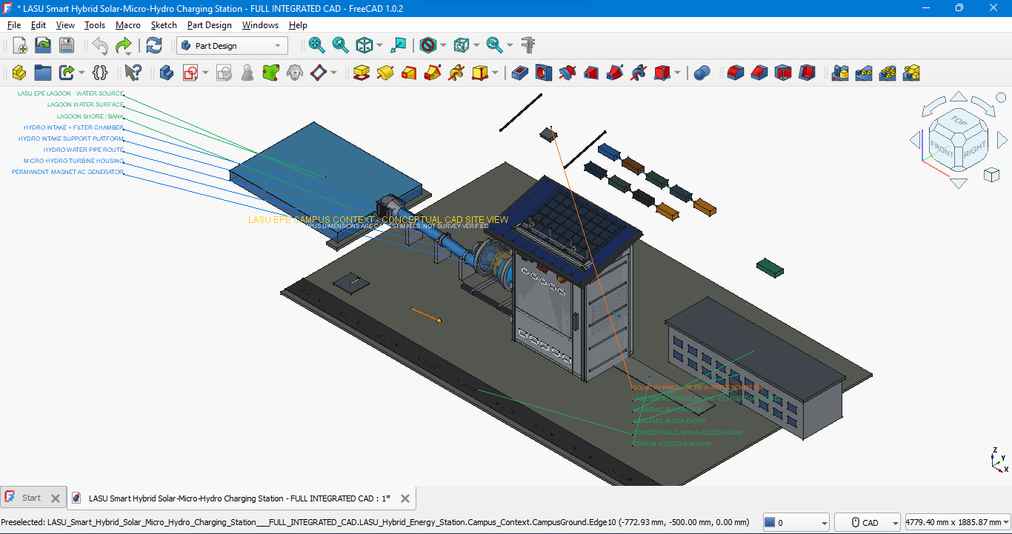

Slide 7
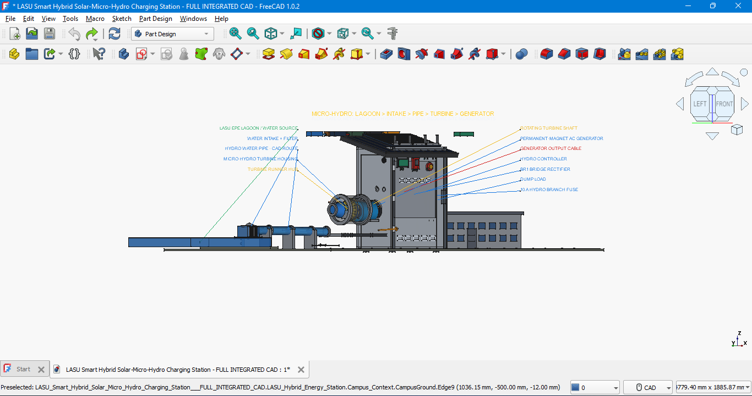

Slide 8
We also completed the electrical schematic design using KiCad. The schematic represents the electrical connections and the integration of the major components of the hybrid charging system.
The project is currently at the design and development stage, with the CAD design and electrical schematic completed. The next step is to review both designs, make any necessary corrections, and prepare for the physical prototype development.
NEXT STEPS
We will continue refining the designs, checking the compatibility of the mechanical and electrical components, and planning the construction and testing of the physical prototype.

Slide 9
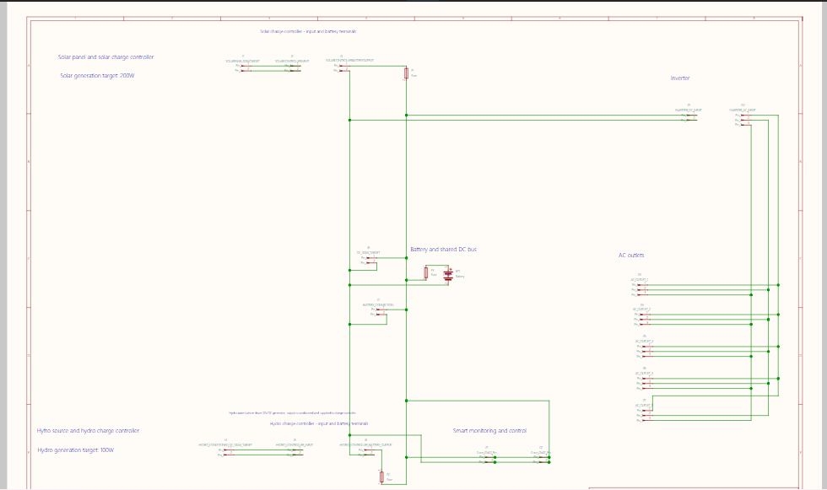

Slide 10
THANK YOU!!!!!

